Slide 1



Guiding Document for the Professional Learning Plan

Slide 2
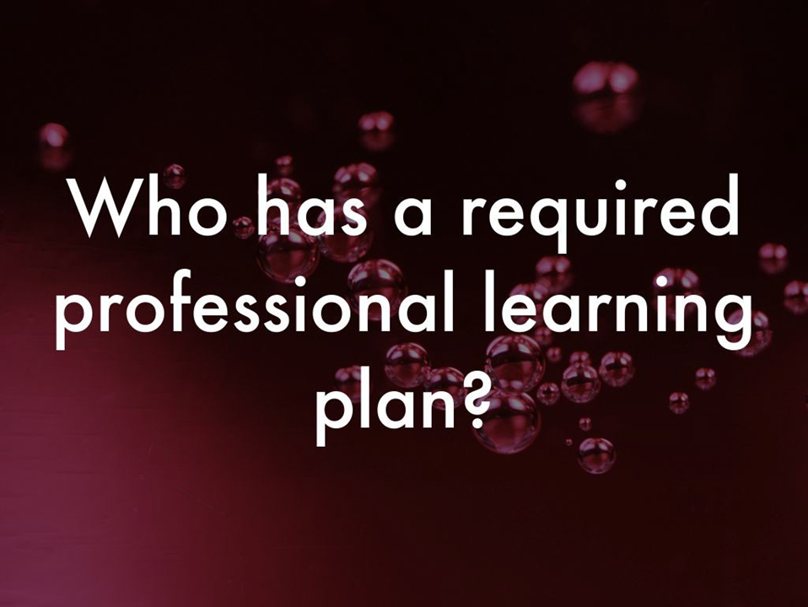

Slide 3
Required PL Plans
Educators with required PLPs:
Induction level educators
Educators working on non-renewable certificates
Educators in new positions
Those returning after an absence from the profession
Educators new to the state
Those with annual performance ratings below proficient or below satisfactory

Slide 4
PLP Components
•Goal(s) Statement
•Data to support selection of the goal(s)
•Link to TAPS/LAPS performance standards or, for induction teachers, GACE/key assessment data
•Strategies
•Documentation
•Timeline

Slide 5
Job-Embedded Learning
•Working on the work
•Working collaboratively
•Using workshops and other resources to support the work of teaching and learning
•Learning to use protocols to guide professional learning

Slide 6
CSU’s Commitment to You
Each student teacher seeking initial certification is required to complete the Guiding Document for the Professional Learning Plan as one of the requirements for satisfactorily completing his/her program at Columbus State University. The purposes for completing the Guiding Document are:
(1) Induction level teachers are required to have Professional Learning Plans (PLPs) for the length of time they hold an Induction Certificate; therefore, the faculty and staff at Columbus State University want to support you as you analyze your student teaching data to inform your induction level PLP.
(2) The Guiding Document will allow you to identify your areas of strength, areas for growth, ways in which you can be supported, and professional learning goals.
(3) Columbus State University’s faculty and staff will use the data collected within the Guiding Document to partner with school districts in terms of developing job-embedded, professional learning opportunities and resources that will support you throughout your first year of induction.
(4) Finally, after your first year as an induction teacher, Columbus State University’s faculty and staff will follow-up with you to identify the progression towards meeting your professional learning goals and work with you to identify new professional learning goals, based on data, in an effort to continue supporting you.

Slide 7
Outcomes & Benefits
Use Data to Develop Professional Learning Goals
Personal Goals Reflecting Intentional Attention to Students with Disabilities and Culturally Diverse Students
Articulate Areas of Strength and Areas for Improvement with HR Directors, Administrators, and/or Mentor Teachers
Alignment of Data with TAPS (Common Language/Common Understanding)
Inform Professional Development (PD)
Advocate for Support, Resources, and Specific PD that Align with Areas for Improvement
Provides Needs Assessment to Inform PD for Partnership Opportunities Between School Districts and EPPs

Slide 8
Q & A
fuller_berderia@columbusstate.edu

