Slide 1
CRMC Winter Project Workshop
January 23, 2018

Slide 2
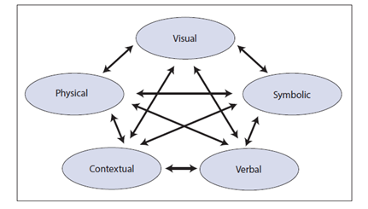
Multiple Representations

Slide 3
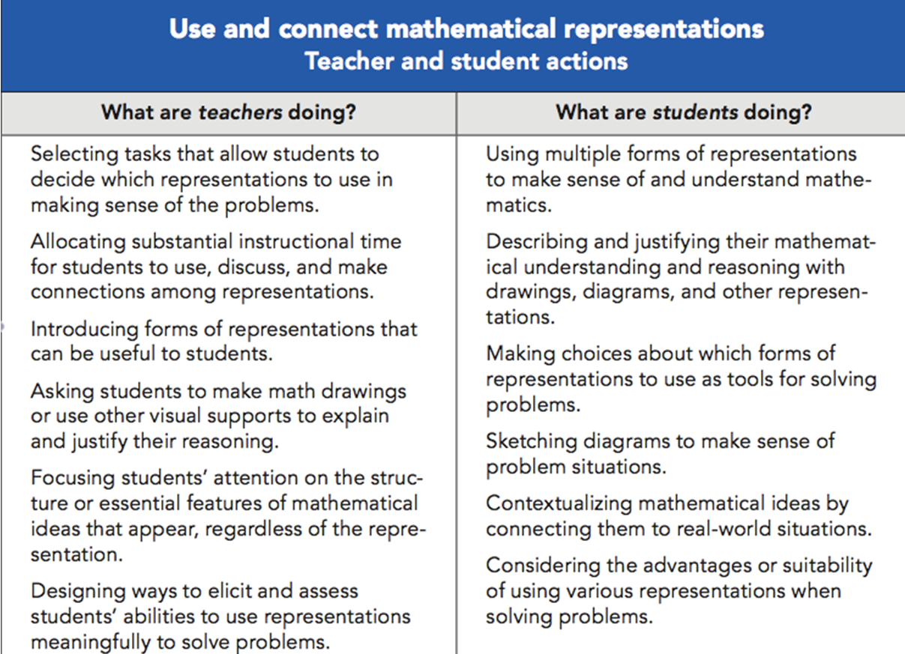
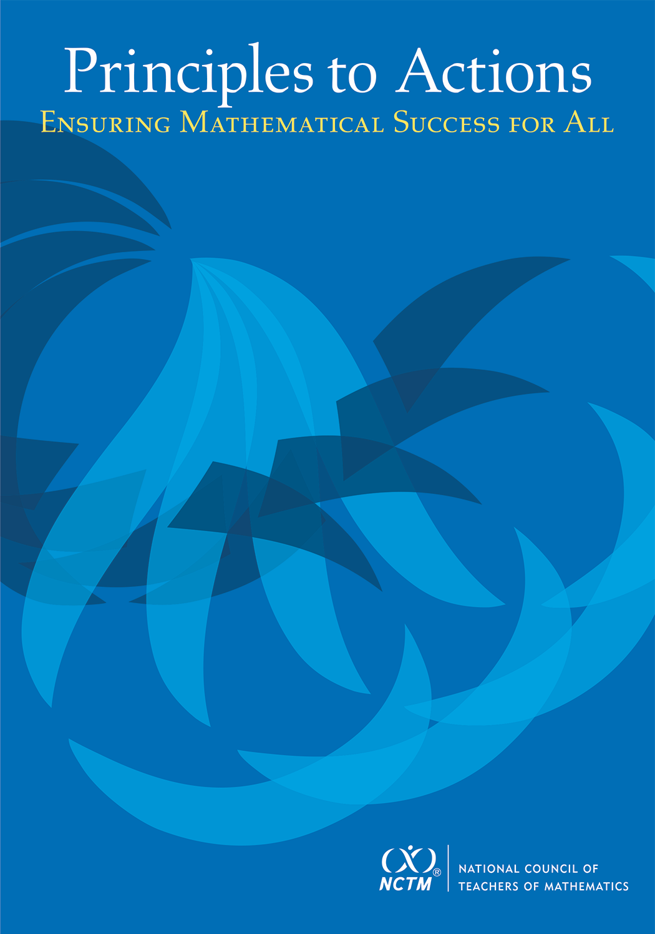

Slide 4
Remember…
"Struggling in mathematics is not the enemy any more than sweating is in basketball. It is a clear sign that you are in the game."

Slide 5
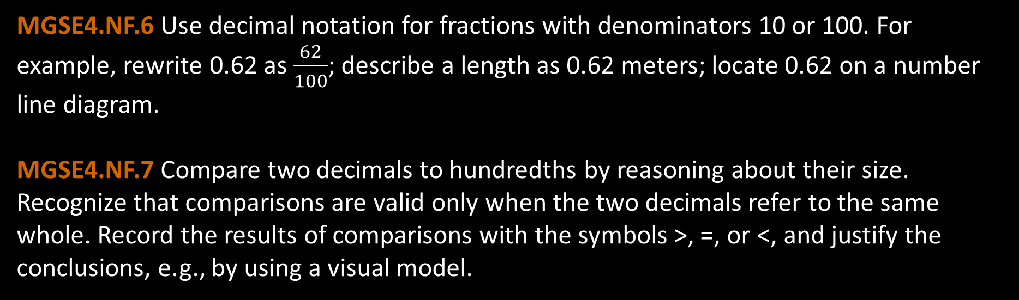
MGSE4.NF.6 Use decimal notation for fractions with denominators 10 or 100. For example, rewrite 0.62 as $\frac{62}{100}$; describe a length as 0.62 meters; locate 0.62 on a number line diagram.
MGSE4.NF.7 Compare two decimals to hundredths by reasoning about their size. Recognize that comparisons are valid only when the two decimals refer to the same whole. Record the results of comparisons with the symbols >, =, or <, and justify the conclusions, e.g., by using a visual model.
MGSE5.NBT.7 Add, subtract, multiply, and divide decimals to hundredths, using concrete models or drawings and strategies based on place value, properties of operations, and/or the relationship between addition and subtraction; relate the strategy to a written method and explain the reasoning used.
MGSE6.NS.3 Fluently add, subtract, multiply, and divide multi-digit decimals using the standard algorithm for each operation.

Slide 6
Addition of Decimal Numbers
Why must we “line up” our decimals in addition problems?

Slide 7

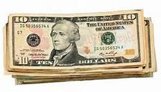


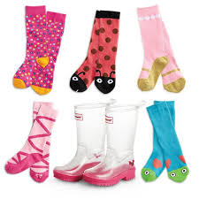
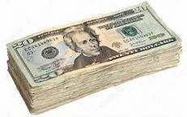

What is Addition?
The putting together of like things

Slide 8
Adding Decimal Numbers (Estimate first!)
0.43 + 0.51
56.25 + 1.87
9.875 + 0.34
0.87+ 0.3

Slide 9



Slide 10
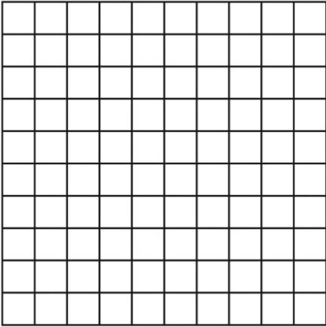
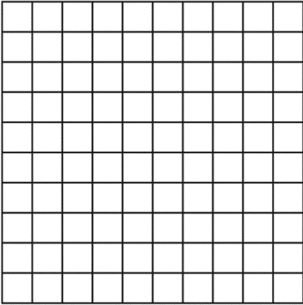
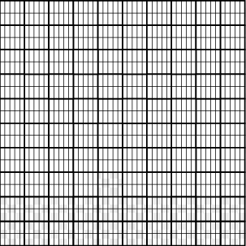

Slide 11
Multiplication of Decimal Numbers
Why don’t we “line up” our decimals when we multiply decimal numbers?

Slide 12
Conceptual Multiplication
What does it mean to multiply?
How can knowledge of conceptual multiplication help students determine answers to decimal multiplication problems?

Slide 13
8.25 x 6.34
Use these digits –
52305
1. Given these digits, place the decimal by estimation.
2. Compare the decimal placement to placement via the algorithm.

Slide 14
Based on your estimation skills, give exact answers to the problems below. Justify your answers using number sense.
2.4 x 0.63
2.4 x 6.3
24 x 0.63
2.4 x 63
0.24 x 0.63
Limits of this method? 0.024 x 0.063
Use this equation
24 x 63 = 1,512

Slide 15

0.24 x 6.3
$\frac{24}{100}$ $×6\frac{3}{10}$ $= \frac{}{?}$
2.4 x 0.63
2.4 x 6.3
24 x 0.63
2.4 x 63
0.24 x 0.63
Why Does the Decimal go There?
Linking Decimal Placement to Decimal Fractions

Slide 16
The Distributive Property & Area Model
3.5 x 8.25
(3 + 0.5)(8 + 0.25)

Slide 17


Partitive Division
4
Size of group
6
24
Total Apples
Number of groups

Slide 18
MGSE4.NBT.6 Find whole-number quotients and remainders with up to four-digit dividends and one-digit divisors, using strategies based on place value, the properties of operations, and/or the relationship between multiplication and division. Illustrate and explain the calculation by using equations, rectangular arrays, and/or area models.
MGSE5.NBT.6 Fluently divide up to 4-digit dividends and 2-digit divisors by using at least one of the following methods: strategies based on place value, the properties of operations, and/or the relationship between multiplication and division. Illustrate and explain the calculation by using equations or concrete models. (e.g., rectangular arrays, area models)

Slide 19

Division: The Algorithm But, why does it work?
1,235 $÷$ 5 =

Slide 20

Division of Decimal Numbers
Purposeful digit choice in equation and divisor
31.64 $÷$ 2 =
Where does the decimal go? Why?

Slide 21
Measurement Division
4
Number of groups
6
24
Total Apples
Size of group

Slide 22

Division: Partitive & Measurement Models using Cuisenaire Rods
1. $\frac{0.8}{4}$ 5. $\frac{1.8}{0.9}$
2. $\frac{1.8}{9}$
3. $\frac{1.5}{3}$
4. $\frac{0.8}{0.4}$
Create a physical model and contextual example for each problem.

Slide 23
MGSE4.OA.5 Generate a number or shape pattern that follows a given rule. Identify apparent features of the pattern that were not explicit in the rule itself. Explain informally why the pattern will continue to develop in this way. For example, given the rule “Add 3” and the starting number 1, generate terms in the resulting sequence and observe that the terms appear to alternate between odd and even numbers.
MGSE6.EE.6 Use variables to represent numbers and write expressions when solving a real-world or mathematical problem; understand that a variable can represent an unknown number, or, depending on the purpose at hand, any number in a specified set.
MGSE7.EE.4c Solve real-world and mathematical problems by writing and solving equations of the form x+p = q and px = q in which p and q are rational numbers.
MGSE8.EE.7 Solve linear equations in one variable.
MGSE8.EE.8 Analyze and solve pairs of simultaneous linear equations (systems of linear equations).

Slide 24
Sequences: Arithmetic vs. Geometric
A sequence is a set of numbers written in a particular order.
They each start with a particular first term, and then to get successive terms we just add a fixed value to the previous term.
So the difference between consecutive terms in each sequence is a constant.
A geometric sequence is a sequence where each new term after the first is obtained by multiplying the preceding term by a constant r, called the common ratio.

Slide 25
Function Machine
https://phet.colorado.edu/sims/html/function-builder/latest/function-builder_en.html
A rule for matching elements of two sets of numbers
An input value from the first set has only one output value in the second set.
A relationship

Slide 26
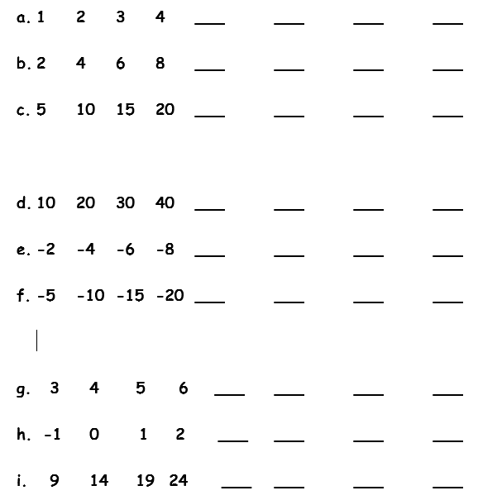
Patterns Lead to Functions

Slide 27
What’s My Rule? A Verbal Representation of the Relationship Between the Step Number and the Total
_________________
_________________
_________________
_________________
_________________
_________________
_________________
_________________
_________________

Slide 28
Input-Output Tables A-D
Input x | Math Story “A” | Output y
Input x | Math Story “B” | Output y
Rule:
Rule:
Input x | Math Story “C” | Output y
Input x | Math Story “D” | Output y
Rule:
Rule:

Slide 29
Input-Output Tables E-H
Input x | Math Story “E” | Output y
Input x | Math Story “F” | Output y
Rule:
Rule:
Input x | Math Story “G” | Output y
Input x | Math Story “H” | Output y
Rule:
Rule:

Slide 30
Input-Output Table I
Input x | Math Story “I” | Output y
Rule:

Slide 31
Formula for an Arithmetic Sequence
An arithmetic sequence can be defined by an explicit formula in which…
a _{n} = d (n - 1) + c
d is the common difference between consecutive terms
c = a ₁
How does this formula relate to y=mx+b
What is the intuitive way of writing the arithmetic sequence formula?

Slide 32
The Vocabulary of Linear Functions
Relationship
Step number
Direction Variation
Slope-intercept form
Constant
Constant of proportionality; Rate of change
Slope
y-intercept (Merriam-Webster: to gain possession of)
Total
“nth” term
Recursive
Explicit

Slide 33
The coefficient of the “x” variable
What is the purpose of this coefficient?

