Slide 1
Unit Rates & Equations

Slide 2
Georgia Standards of Excellence
MGSE7.RP.2b Identify the constant of proportionality (unit rate) in tables, graphs, equations, diagrams, and verbal descriptions of proportional relationships.
MGSE7.RP.2c Represent proportional relationships by equations.
MGSE7.RP.2d Explain what a point (x, y) on the graph of a proportional relationship means in terms of the situation, with special attention to the points (0, 0) and (1,r) where r is the unit rate.

Slide 3



Slide 4

Bridget says she is able to text 45 words in 15 seconds.
How many words can she text in 1 second?
Ratio
Unit Rate

Slide 5

Visual Representation of the Data

Slide 6

José told Bridget that he can text faster than she can. José can text 48 words in 12 seconds. How many words can he text in 1 second?
Ratio
Unit Rate

Slide 7

Visual Representation of the Data

Slide 8


Expressing the Relationship Verbally
?
Variables
Independent
Dependent

Slide 9
Expressing the Relationship Symbolically
How could I determine how many texts Bridget and José can send in any amount of time?
Variables

Slide 10
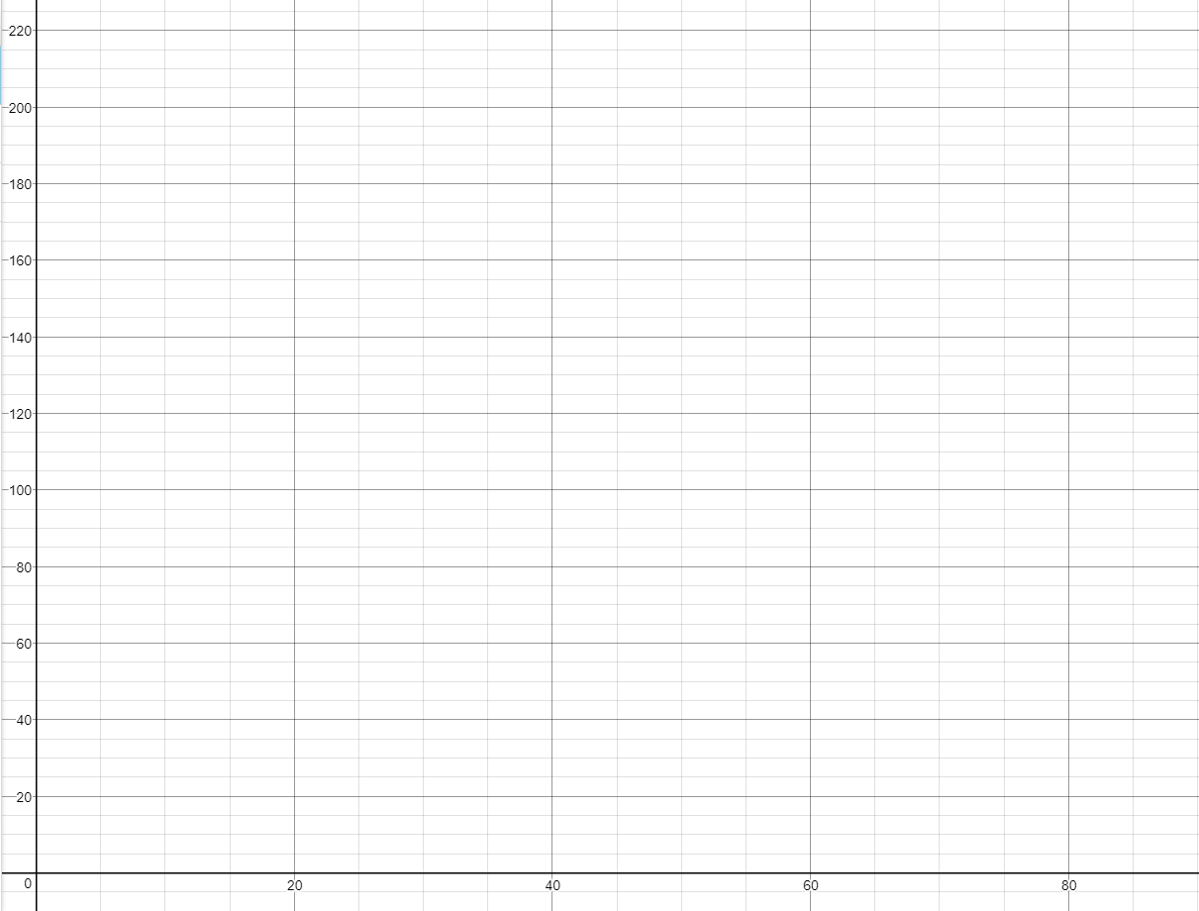

Slide 11
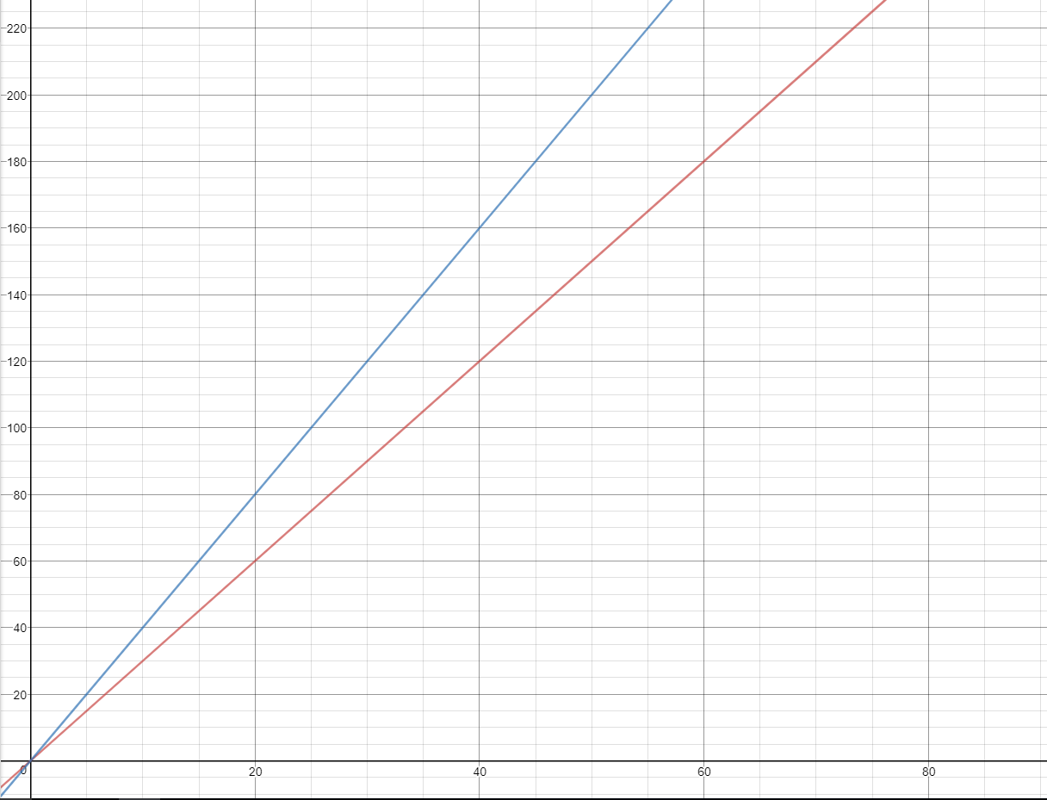

Slide 12
The Graph
What do you notice?
Why is one line more steep than the other?
How is the line steepness related to unit rate?
Use your graph to determine how many texts Bridget can send in 40 seconds. José?

