Slide 1
Models of Division

Slide 2
GSE
MGSE6.NS.1 Interpret and compute quotients of fractions, and solve word problems involving division of fractions by fractions, including reasoning strategies such as using visual fraction models and equations to represent the problem.
Note: The predecessor for MGSE6.NS.1 is MGSE3.OA.2 Interpret whole number quotients of whole numbers, e.g., interpret 56 ÷ 8 as the number of objects in each share when 56 objects are partitioned equally into 8 shares (How many in each group?), or as a number of shares when 56 objects are partitioned into equal shares of 8 objects each (How many groups can you make?). For example, describe a context in which a number of shares or a number of groups can be expressed as 56 ÷ 8.
This presentation is a review of MGSE3.OA.2 in preparation for MGSE6.NS.1

Slide 3


Situation 1
Malia has twelve (12) emoji-face cookies. She has four (4) friends she’d like to surprise with the cookies.

Slide 4
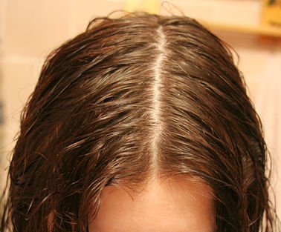

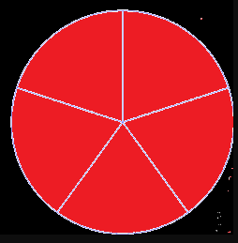

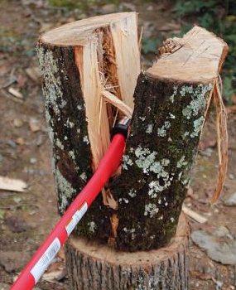
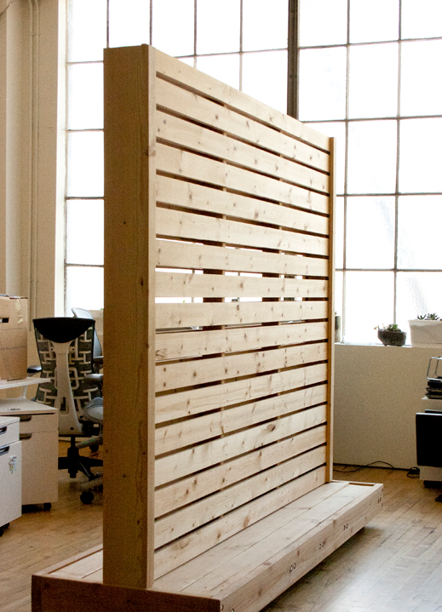

Partitive Division

Slide 5
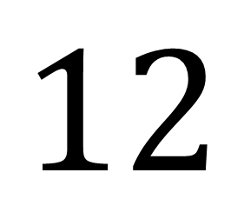

3
Size of groups
$$4$$
$$12$$
Number of groups
Total
Partitive Division

Slide 6
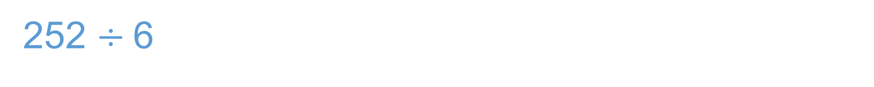
252 $÷$6
252
-120
132
6 groups of 42 is 252
6 x 42 = 252
20
2
2
132
- 120
12
20
20
20
20
2
20
20
2
20
2
20
20
20
2
20
12
- 12_
0

Slide 7

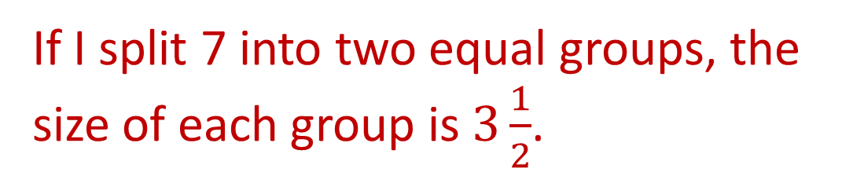

Think: I need to partition/split 7 into 2 equal groups…
Ask: What is the size of each group?
$$7÷2=3\frac{1}{2}$$
If I split 7 into two equal groups, the size of each group is $3\frac{1}{2}$.

Slide 8
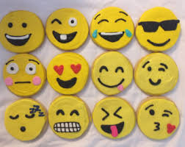
Situation 2
Sasha has 12 emoji-face cookies. She wants to surprise some friends by giving them 4 cookies each.

Slide 9
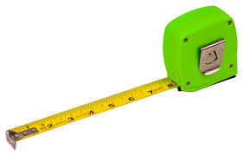
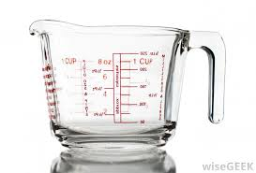
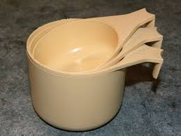
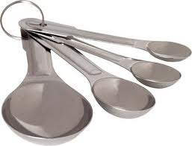
Measurement Division

Slide 10
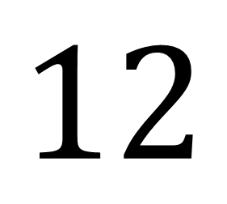

3
Number of groups
$$4$$
$$12$$
Total
Size of groups
Measurement Division

Slide 11
Think: 7 is being measured out 2 at a time.
Ask: How many groups of 2 can be made from (or measured out) from 7?

Slide 12


Repeated Subtraction
$7$ – 2 = 5
1 group of 2
5 – 2 = 3
2 groups of 2
3 – 2 = 1
3 groups of 2
1 remains out of a group size of 2
$$7÷2=3\frac{1}{2}$$
I can make $3\frac{1}{2}$ groups of 2 from 7.

Slide 13
Situation 1: Malia has 12 emoji-face cookies. She has four friends she’d like to surprise with the cookies. How many cookies will each friend get? | Situation 2: Sasha has 12 emoji-face cookies. She wants to surprise some friends by giving them 4 cookies each. How many friends will receive some of Sasha’s cookies?
What information do you know? | What information do you know?
What information is missing? | What information is missing?

Slide 14
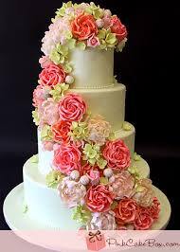
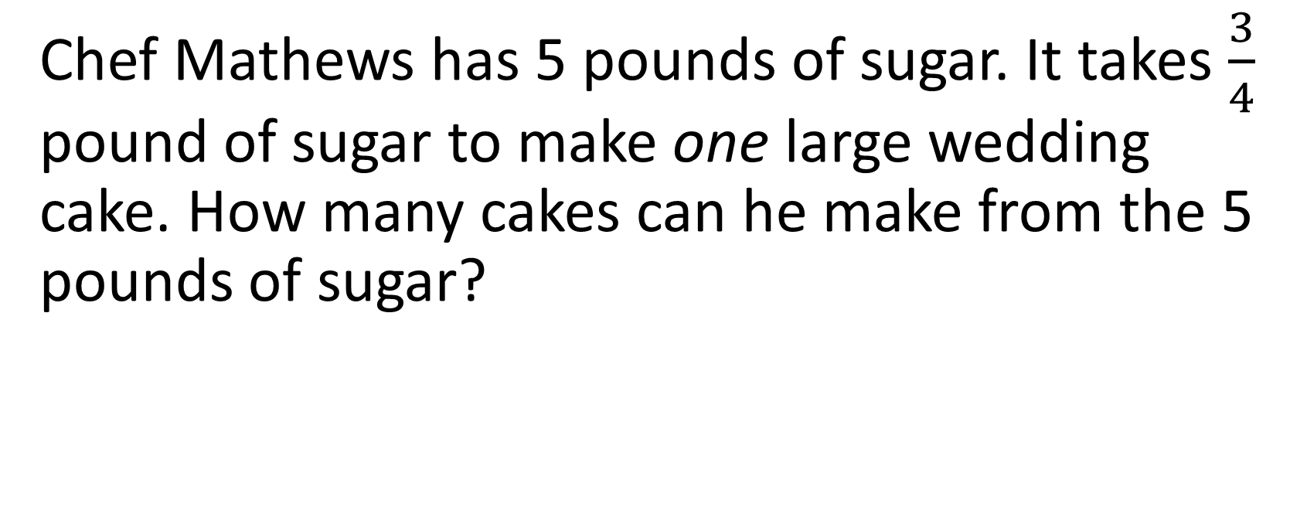
Which Model of Division?
Chef Mathews has 5 pounds of sugar. It takes $\frac{3}{4}$ pound of sugar to make one large wedding cake. How many cakes can he make from the 5 pounds of sugar?

Slide 15
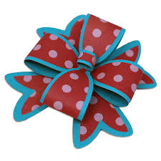
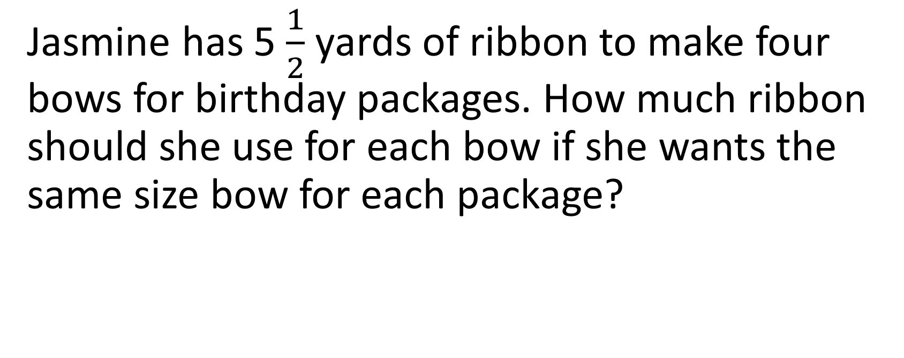
Which Model of Division?
Jasmine has 5 $\frac{1}{2}$ yards of ribbon to make four bows for birthday packages. How much ribbon should she use for each bow if she wants the same size bow for each package?

Slide 16
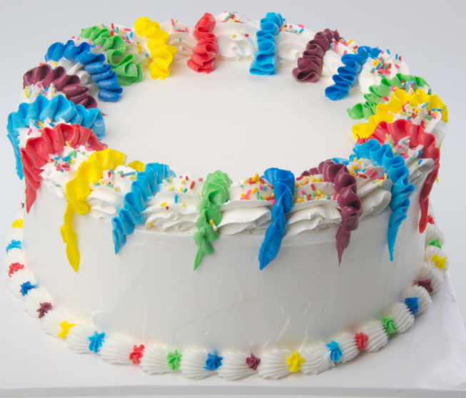
Which Model of Division?
Terri recently had a birthday. There is only one-third of her cake left. It has six candles on it. How old was Terri on her birthday?

