Slide 1
Georgia Standards of Excellence
MGSE6.EE.5
Understand solving an equation or inequality as a process of answering a question: which values from a specified set, if any, make the equation or inequality true? Use substitution to determine whether a given number in a specified set makes an equation or inequality true.

Slide 2

What Do You Notice?
Look over the page of images with your partner(s).
Where have you seen these images?
What do they have in common?
How could you talk about them with math in mind?

Slide 3
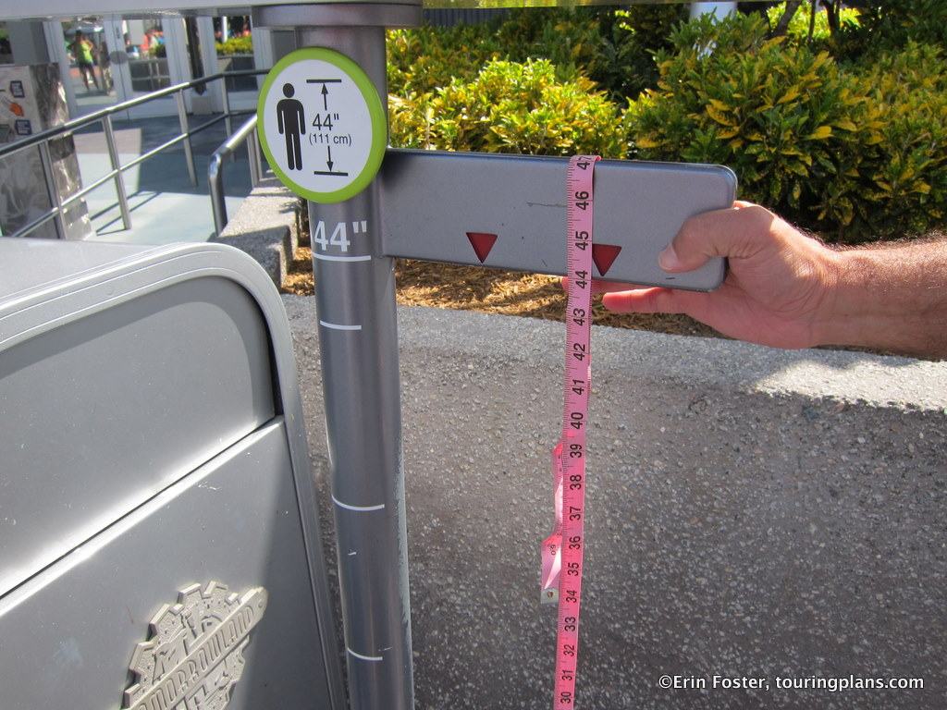

Slide 4


Slide 5
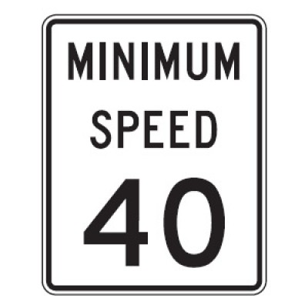

Slide 6
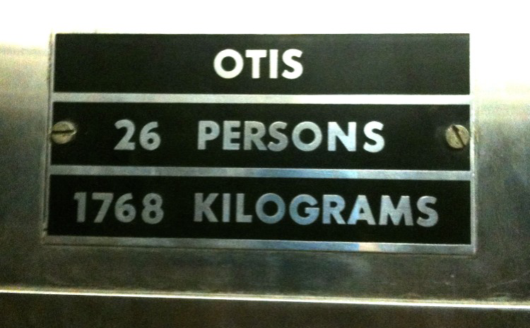
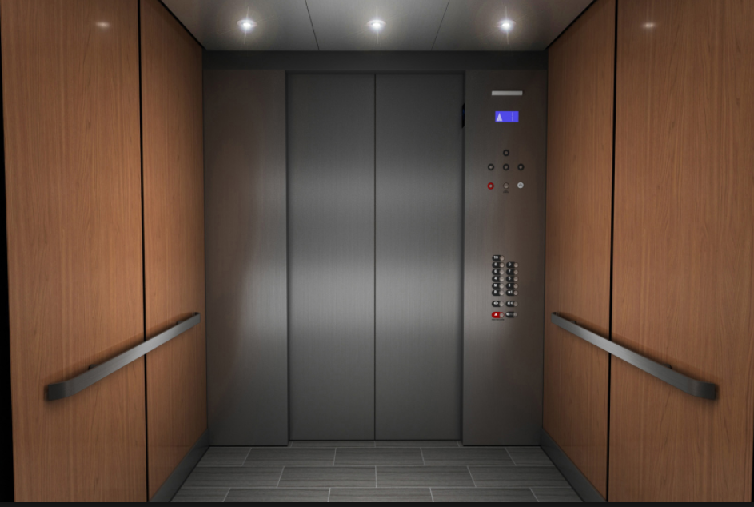

Slide 7


Slide 8


Slide 9
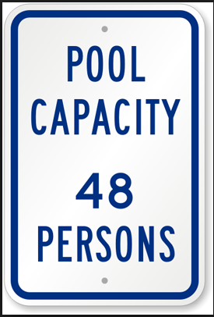

Slide 10
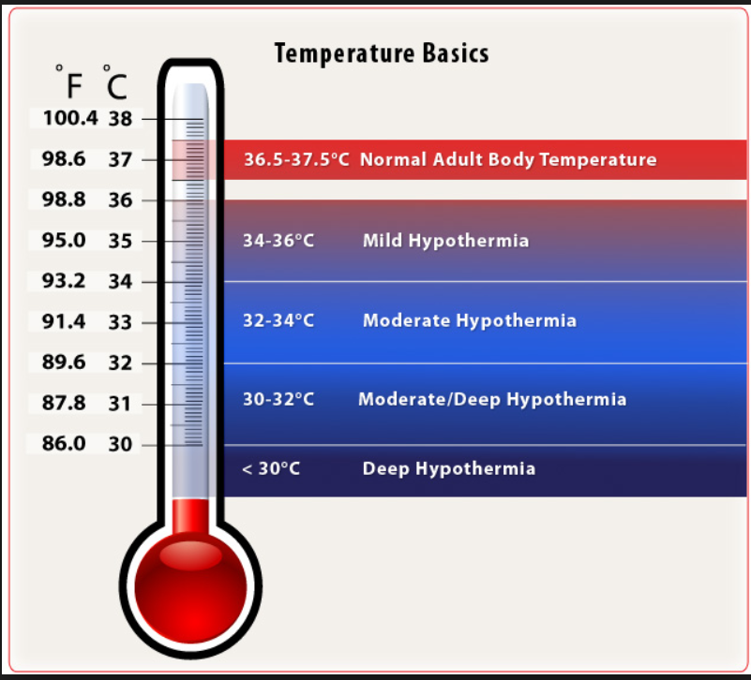

Slide 11



What Does an Equal Sign Mean?

Slide 12
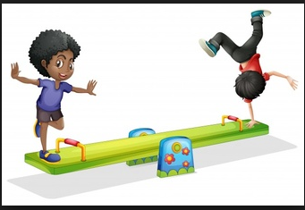

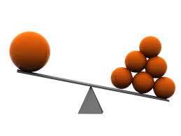

Slide 13
Defining Vocabulary Words with Your Words
Maximum
Minimum

Slide 14
Prefixes: Small Changes That Mean A Lot
What does “in” at the beginning of a word mean?
Incapable
Inattentive
Infinite
Inappropriate
Your examples
inequality

Slide 15
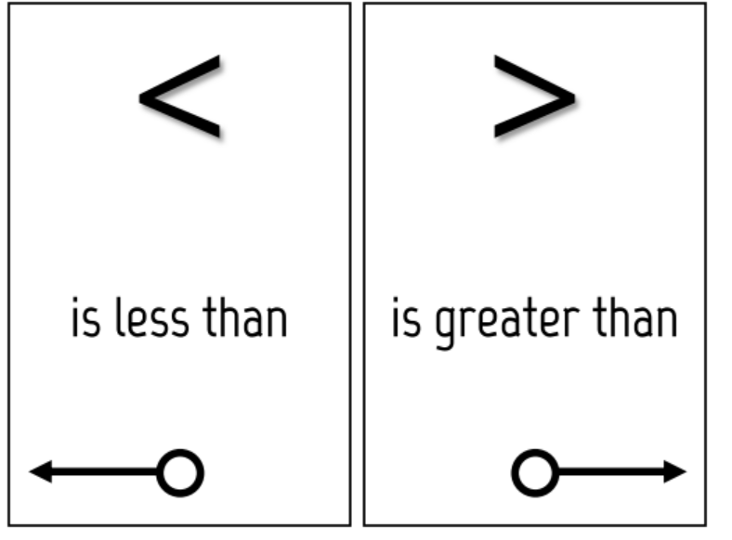
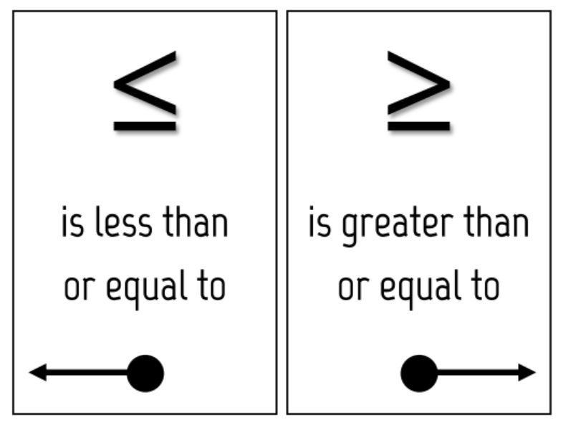

Slide 16




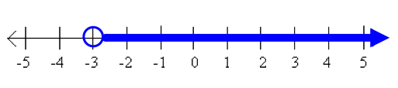



Open or Closed Circle: What Does it Mean?

Slide 17

How Many Correct Answers? WHY?
15 + 6 = n
35 = 20 + n
4n $>12$
9n $<36$

Slide 18
Graphing Solutions

Slide 19

Think About…
“Naked number” inequality problems may have an INFINITE number of solutions, but what about REAL-WORLD problems?

Slide 20
A Task
Jasmine wants to save up enough money to buy a new sports bag. The bag costs $48. Jasmine has $15 she saved from her birthday. To make more money, she plans to wash neighbors’ windows. She will charge $3 for each window she washes. Any extra money she makes beyond $48, she will use to buy a new soccer ball.
Write and solve an inequality that represents the number of windows Jasmine can wash to save, at least, the minimum amount she needs to buy the bag.
Graph the solution on the number line.
What is a realistic number of windows Jasmine could wash?

Slide 22
A Task
Jasmine wants to save up enough money to buy a new sports bag. The bag costs $50. Jasmine has $15 she saved from her birthday. To make more money, she plans to wash neighbors’ windows. She will charge $3 for each window she washes. Any extra money she makes beyond $50, she will use to buy a new soccer ball.
Write and solve an inequality that represents the number of windows Jasmine can wash to save, at least, the minimum amount she needs to buy the bag.
Graph the solution on the number line.
How is this task different from the previous task?

