Slide 1
Finding Areas of Shapes

Slide 2

AREA

Slide 3

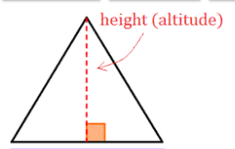
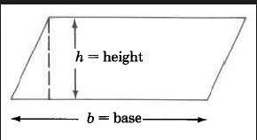
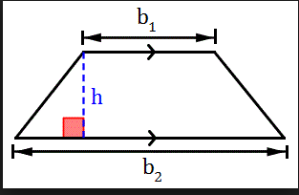
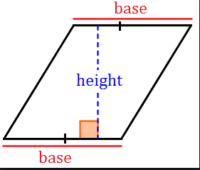
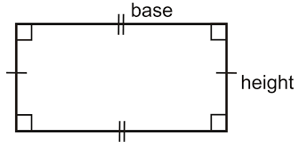
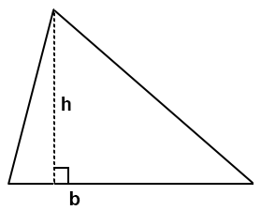
What is Height?

Slide 4
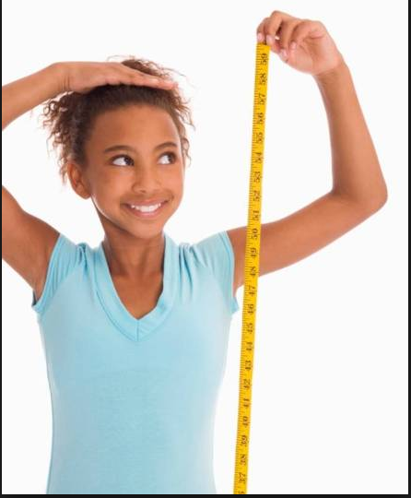
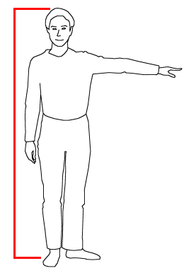
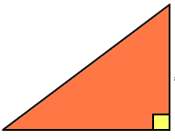
Height
A distance that is perpendicular to a base
Perpendicular means forming a 90° angle with a side (base)
You must make sure you have perpendicularity!

Slide 5
Height of a Triangle
The height of a triangle
Select two vertices
Call the line segment joining these two vertices the base
Find the third vertex
Draw a segment from the third vertex to the base
*What if you had selected two different vertices?

Slide 6
Shape Cutter Tool
https://illuminations.nctm.org/Activity.aspx?id=4206

Slide 7
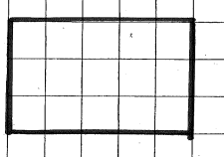
What are some of the characteristics of a rectangle?

Slide 8


Slide 9
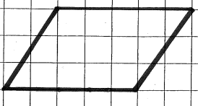
What are some of the characteristics of a parallelogram?

Slide 10
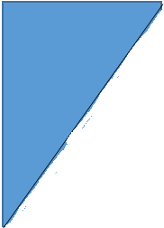

Slide 11

Why Does That Work?
What is happening to the area of the figure we are “cutting off”?
Exchanging
Repurposing
Recycling
Reusing

Slide 12
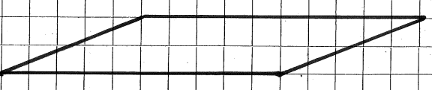

Slide 13


Slide 14

http://thinkmath.edc.org/resource/measurement-discovering-formulas-area

Slide 15

http://thinkmath.edc.org/resource/measurement-discovering-formulas-area

Slide 16
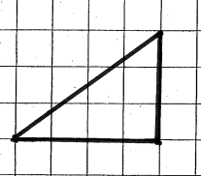
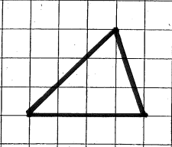

Slide 19
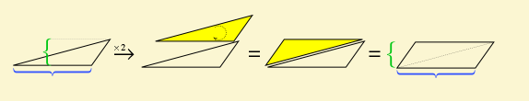
http://thinkmath.edc.org/resource/measurement-discovering-formulas-area

Slide 20
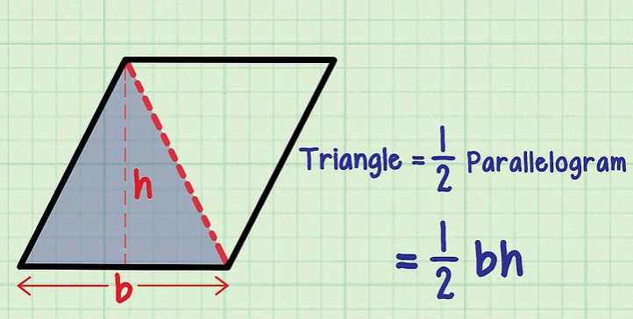

Slide 21
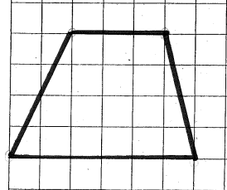
What are some of the characteristics of a trapezoid?

Slide 22
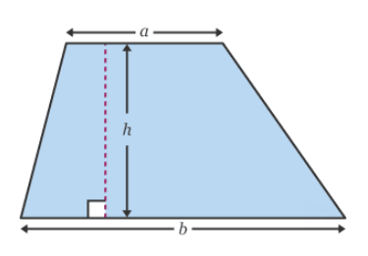

Slide 23
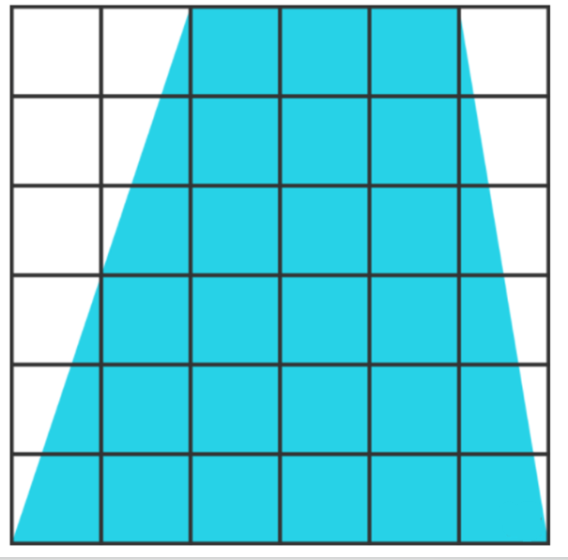
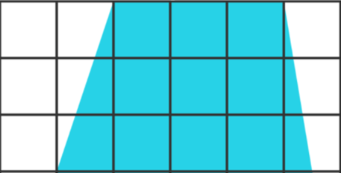
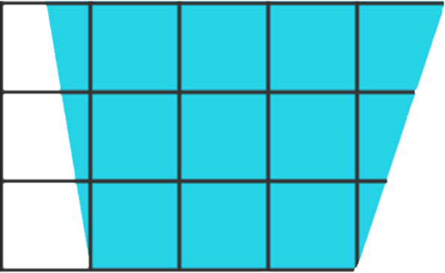

Slide 24


Slide 25

http://thinkmath.edc.org/resource/measurement-discovering-formulas-area

Slide 26

http://thinkmath.edc.org/resource/measurement-discovering-formulas-area

