Slide 1
Creating
Equivalent
Algebraic
Expressions

Slide 2
Algebraic Expressions
Some combination of variables, numbers, operations, and/or grouping symbols
4a
d - 6
p
5(3a + 4)
x + 1

Slide 3

What is a Variable?
+ 5 = 9
- 7 = 16
a, b, c, d, e, f, g, h, i, j, k, l, m, n, o, p, q, r, s, t, u, v, w, x, y, z
a letter or symbol that represents a number or quantities that vary

Slide 4
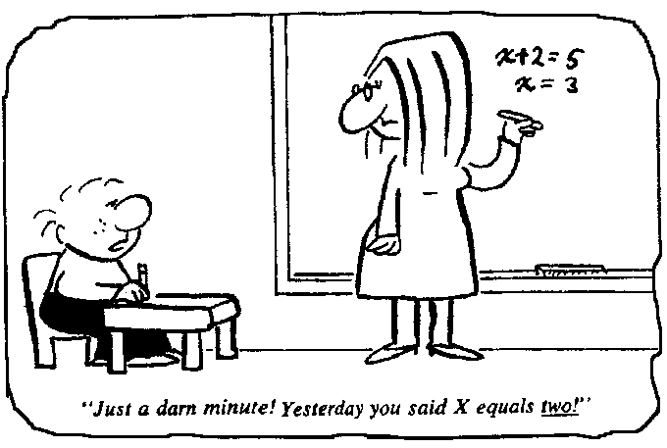

Slide 5
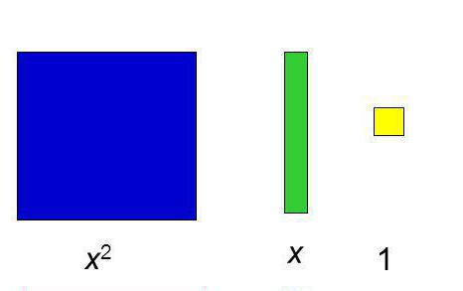
Algebra Tiles

Slide 6
Modeling with Algebra Tiles
What would 3x look like?
What would 3x² look like?
What would 3x² + 4 look like?

Slide 7


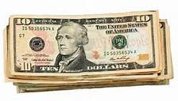

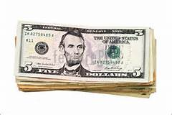
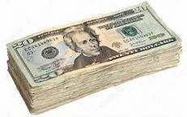

Combining Like Bills

Slide 8
Combining Like Terms
4 + 1x + 3 + 2x
2x² + 3 + 4x + 1x²
x + x + x + x + x

Slide 9
What does it mean to multiply two numbers together?
The number of EQUAL groups x The size of each group
Multiplier
Multiplicand
________________ groups of ________________

Slide 10


What Does this Algebraic Expression Mean? Look Like?
4(x + 3)
This expression means -- four groups of x + 3
The visual representation for this expression is

Slide 11
Symbolic Representation of an algebraic expression | Represent pictorially the number of equal groups using algebra tiles | Write the verbal expression for each pictorial expression in the previous column | Equivalent Symbolic Representation (Factored) | GCF
3x + 9
4x² + 1 + 2x² + 2
6x + 2
3x² + 7
6x² + 3 + 2x + 1
5x + 11
12x² + 8x

Slide 12
Are These Algebraic Expressions Equivalent?
4x + 18 and 2(2x + 9)
7x + 9 and 7(x + 9)
4x² + 8 and 4(x² + 2)
6x² + 15 and 3(2² + 5)
11x² + 16 and 1(11x² + 16)
7x + 13 and 13 + 7x

