Slide 1
Math and Poetry
?

Slide 2
As I was going to St. Ives
I met a man with seven wives.
Each of his wives had seven sacks,
Each of the sacks held seven cats,
Each of the cats had seven kits.
Kits, cats, sacks, and wives.
How many were going to St. Ives?

Slide 3


Slide 4
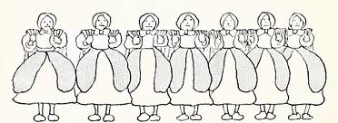

Slide 5
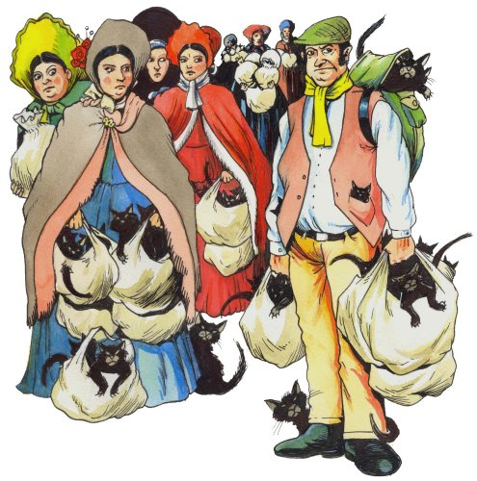

Slide 6
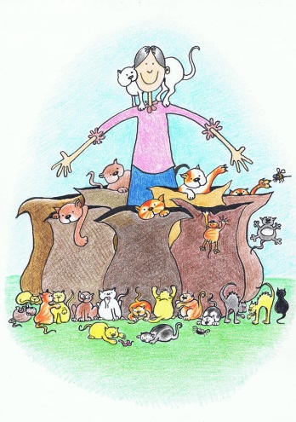

Slide 7
How many were going to St. Ives?

Slide 8
Tools
Pencil
Paper
Colored Pencils
Brain

Slide 9
Man
W W W W W W W

