Slide 1
Planetary Distance from the Sun

Slide 2
www.explorelearning.com

Slide 3
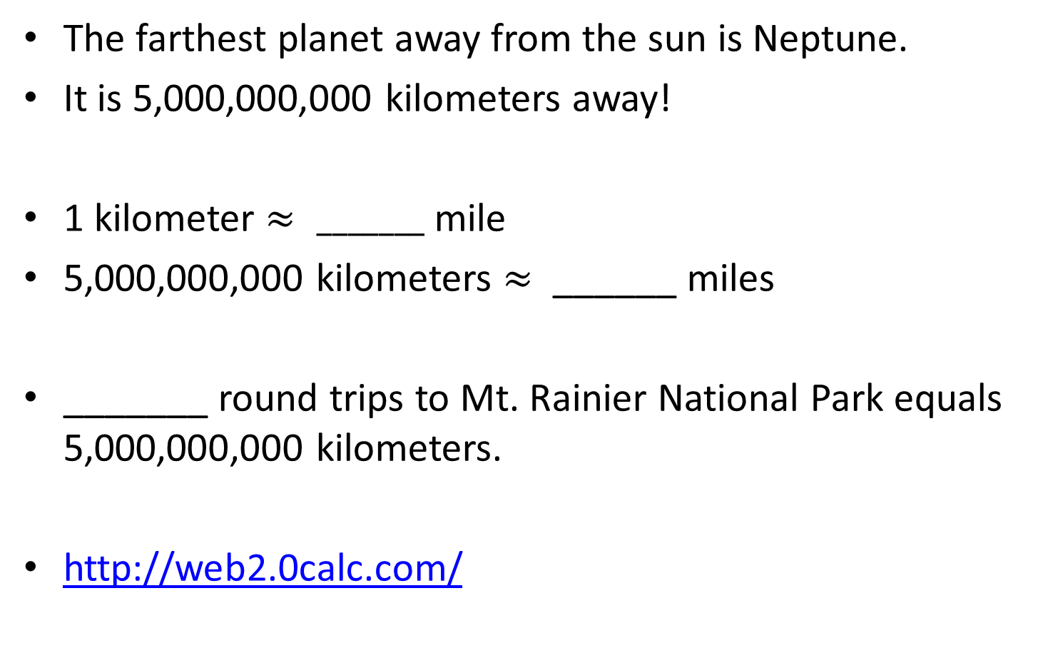
How Much?
The farthest planet away from the sun is Neptune.
It is 5,000,000,000 kilometers away!
1 kilometer $≈ _______$ mile
5,000,000,000 kilometers $≈$ ______ miles
_______ round trips to Mt. Rainier National Park equals 5,000,000,000 kilometers.
http://web2.0calc.com/

Slide 4
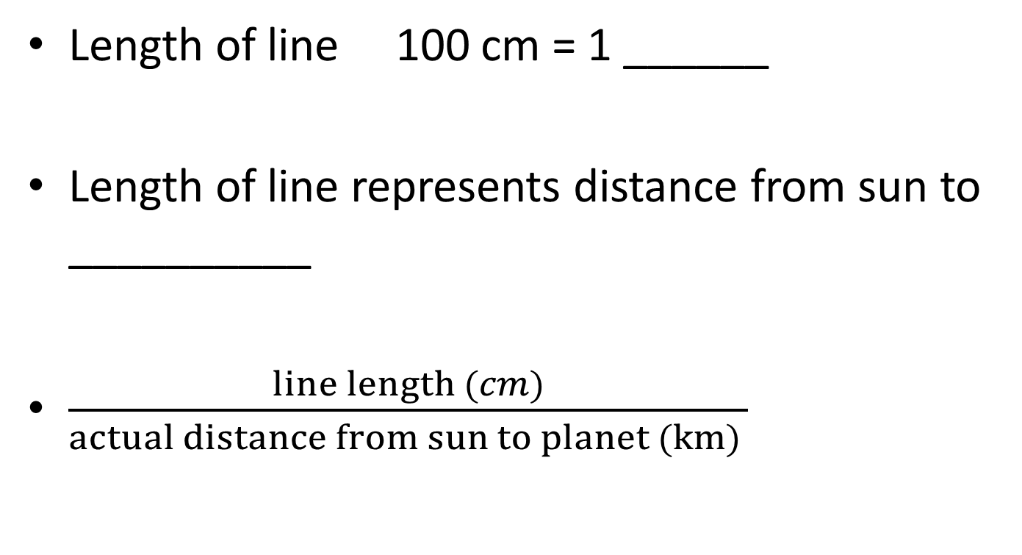
Length of line 100 cm = 1 ______
Length of line represents distance from sun to __________
$\frac{line length (cm)}{actual distance from sun to planet (km) }$

Slide 5
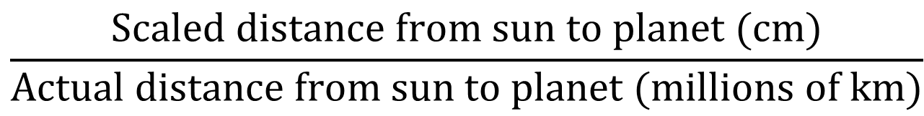
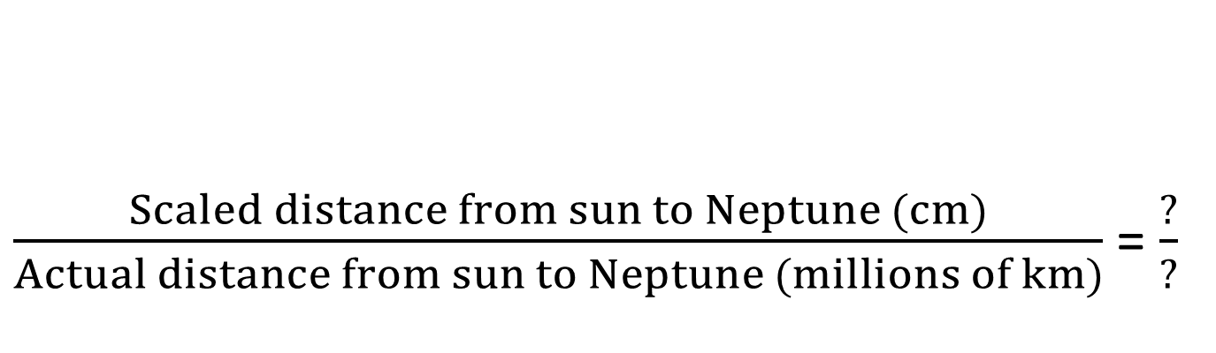
$\frac{Scaled distance from sun to Neptune (cm)}{Actual distance from sun to Neptune (millions of km)}$ = $\frac{?}{?}$
$$\frac{Scaled distance from sun to planet (cm)}{Actual distance from sun to planet (millions of km)}$$

Slide 6
Planet | Distance from the Sun (millions of km) | Scaled distance from sun to Neptune (cm) = Scaled distance (cm) Actual distance from sun to Neptune (km) Actual Distance (km) (millions of km) (millions of km) | Scaled Distance to Sun (cm)
Mercury | 58
Venus | 108
Earth | 150
Mars | 228
Jupiter | 778
Saturn | 1427
Uranus | 2871
Neptune | 4497

