Slide 1
Proportional Reasoning using Manipulatives
Columbus Regional Mathematics Collaborative
Columbus State University
Columbus, Georgia

Slide 2
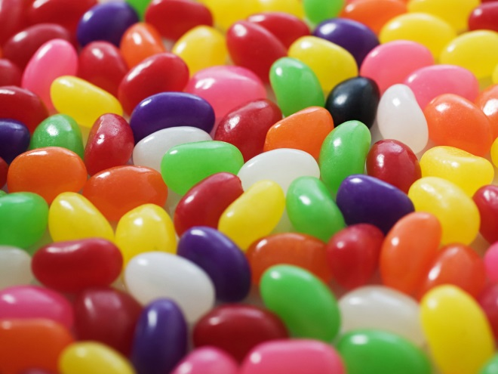
1. The S³ (Sweet, Sweet, Sweet) Candy Company makes 3 purple candies for every 5 non-purple candies. How many non-purple candies would you expect to find in a bag with 27 purple candies?
2. The S³ Company has changed the color recipe! Now, it seems they make 5 non-purple candies for every 4 purple candies. How many purple candies would you expect to find in a bag with 60 non-purple candies?

Slide 3
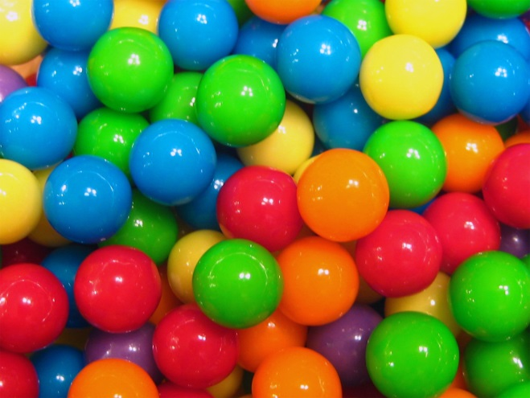
3. We have observed that the S³ Company seems to make 2 orange candies out of every 9 candies. We opened the class-sized bag, and it had 20 orange candies. How many candies would you expect to have in the entire bag?

Slide 4


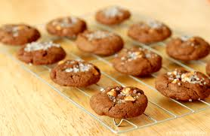
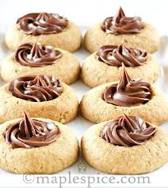

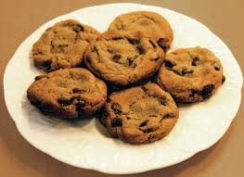
4. 24 cookies were enough to give everyone at a 14-person party a nice half-time snack. How many cookies should we make next year for our 35-person party?

