Slide 1
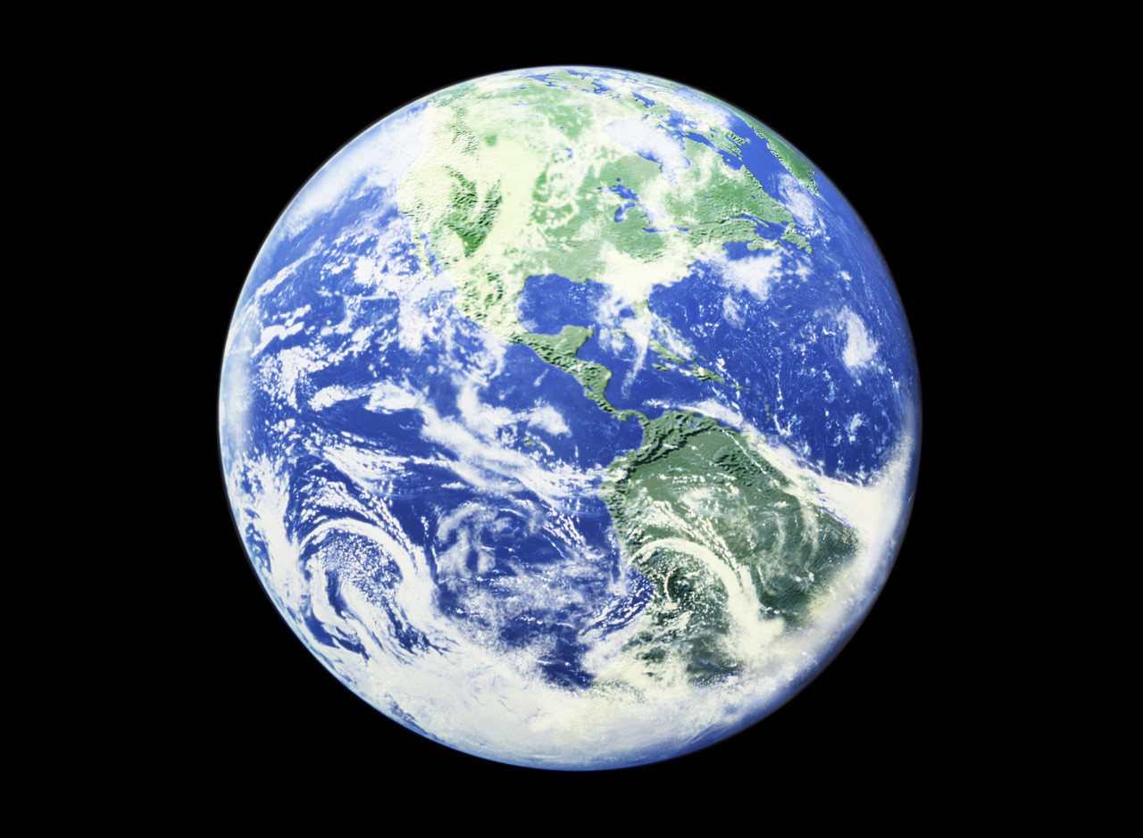
The Make-up of the Earth
February 6, 2014
Ms. Pierce
Eddy Middle School

Slide 3
O C E A N S

Slide 4
L A N D

Slide 5
Uninhabitable
L A N D
O C E A N S

Slide 6
Uninhabitable
L A N D
O C E A N S

Slide 7
Uninhabitable
F
O
O
D
L A N D
O C E A N S

Slide 8
Uninhabitable
Drinkable Water
F
O
O
D
L A N D
O C E A N S

Slide 9
Non-productive zones
Uninhabitable
Drinkable Water
F
O
O
D
Productive Zone
L A N D
O C E A N S
Notes:
Productive – photic – supports photosynthesis
Non-productive

