Slide 1
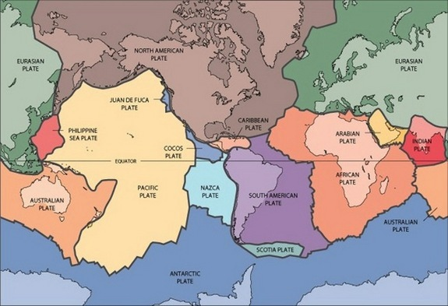
Continental Drift

Slide 2
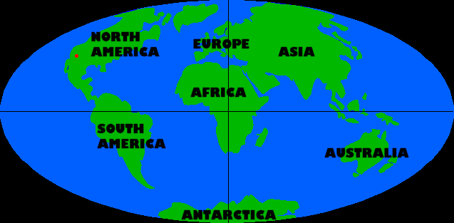

Slide 3
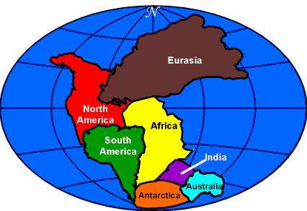
Pangaea
“All the earth”

Slide 4
Pangaea split apart and the different land masses, or continents, drifted to their current locations on the globe
http://www.learner.org/interactives/dynamicearth/drift3.html

Slide 5
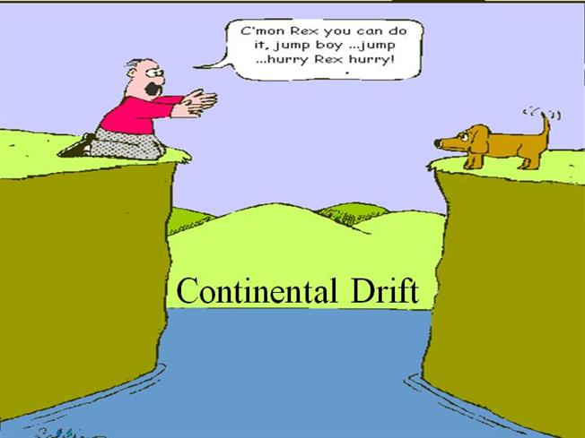

Slide 6
Alfred Wegener (1880-1930)
Found that big geological features (rock formations, mountains) on separated continents often matched very closely when the continents were brought together.
Appalachian Mountains of eastern North
America matched with mountains in Scotland
He was criticized terribly for his theory of “continental drift” because plate tectonics and continental drift was not well understood until the 1960s and 1970s.

Slide 7
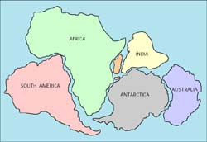
If we know the age of a rock formation…
with its distinctive composition, structure, or fossils
mapped on one side of a plate boundary
We can…
match this rock formation with the same formation on the other side of the boundary
Then, we can…
measure the distance that the formation has moved apart
give an estimate of the average rate of plate motion

Slide 8
Ratio
Comparison of two quantities by division
Examples:
Unit Rate
A comparison of two quantities
The second term has a value of 1.
Examples:

Slide 9

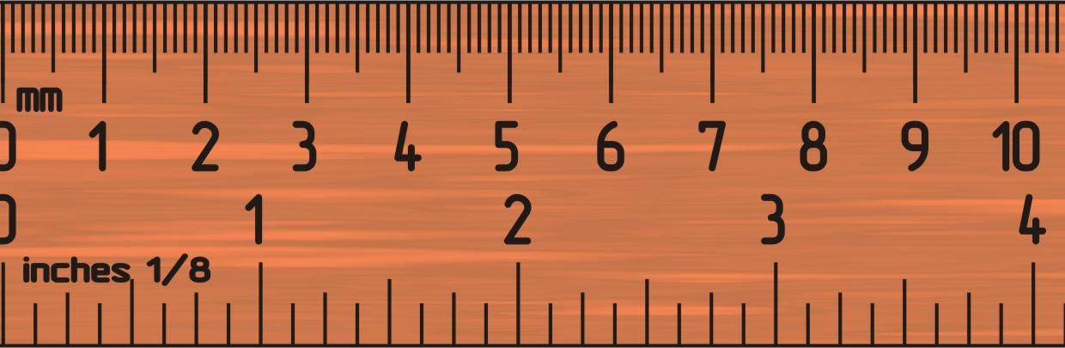
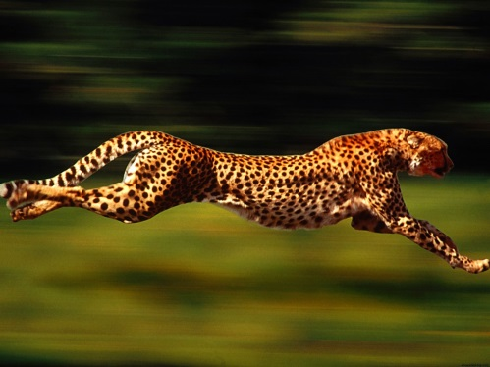
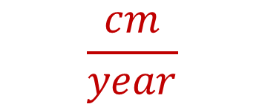
Where’s the Math?
Time
Distance
Speed
Units
Year
$$\frac{cm}{year}$$
Centimeter

Slide 10

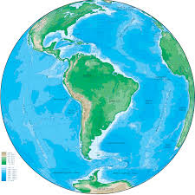
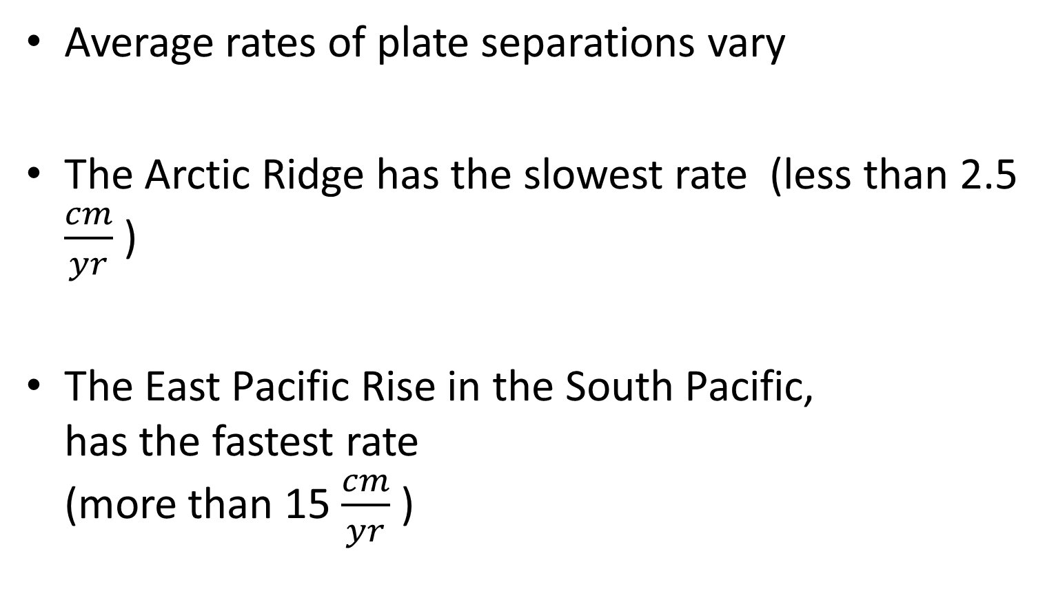
Plate Separation
Average rates of plate separations vary
The Arctic Ridge has the slowest rate (less than 2.5 $\frac{cm}{yr}$ )
The East Pacific Rise in the South Pacific, has the fastest rate (more than 15 $\frac{cm}{yr}$ )

Slide 11

How Much Movement?
2.5 $\frac{cm}{yr}$

Slide 12
Plate Movement Compared To…
An American football field (goal line to goal line) is 100 yards which equals 9144 centimeters
How many years would it take the Artic Ridge to move the length of a football field?

Slide 13

How Much Movement?
15 $\frac{cm}{yr}$

Slide 14
Plate Movement Compared To…
Your classroom is ________ feet long which equals about ________ centimeters
How many years would it take the East Pacific Rise to move the length of your classroom?

