Slide 1
Functions and Modeling Fall Follow-Up September 24, 2015

Slide 2
Agenda
8:30 – 9:00 Welcome/Sign-in/Warmup
9:00 – 10:30 Kenneth Jones Bottle Problem
10:30 -10:35 BREAK
10:35 – 11:45 Balloon Activity
11:45 -12:30 WORKING LUNCH
12:30 – 1:45 Trig Trainer
1:45 – 3:00 Outdoor Experiments
3:00 – 4:00 You Choose

Slide 3
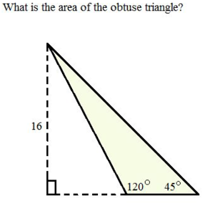
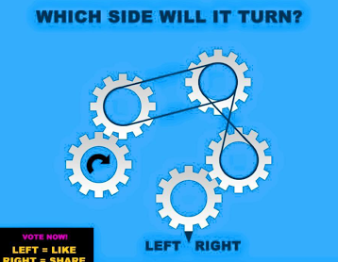
Try These

Slide 4
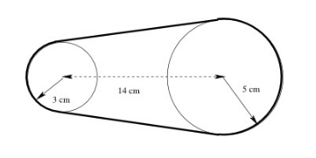
Math Modeling?

Slide 6
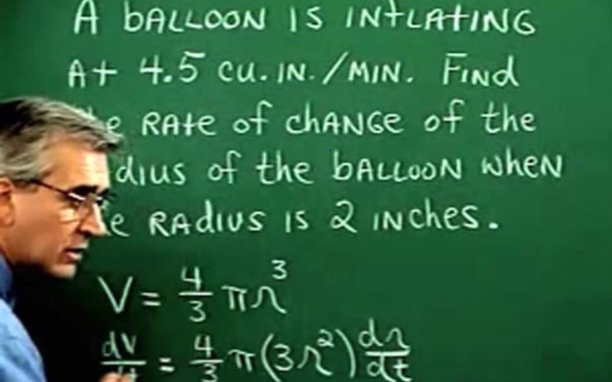
Calculus: Related Rate

Slide 7
You Choose
Trig Trainer Three
Breaking Up Is Not Hard To Do
More Illuminations
Next Steps

